Slide 1



Tealeaf on Cloud Training - Advanced Reporting Options - Session Search Techniques - Alert Management - Basic Event Building
Steven Perry
Parimala Rapol
August 21, 2019
www.pereion.com

Slide 2
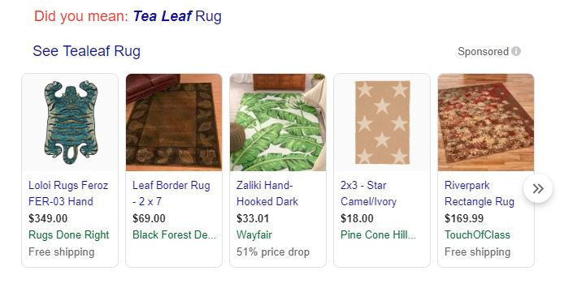
Welcome to the Tealeaf RUG

Slide 3
Tealeaf on Cloud Training Overview
Objective: The course objective is to provide the opportunity to beginner level Tealeaf on Cloud users to develop intermediate level skills.
Approach: The course will focus on advanced reporting, session search capabilities, alert management combined with basic event development training. This will be a hands training session.
www.pereion.com

Slide 4
Tealeaf on Cloud Training Guidelines
This is a Hands on lab training session, we want you to be able to work in your own Tealeaf environment as we demonstrate specific items
Take notes in the PPT file during the session
We will address off topic questions by putting them in a parking lot and come back to them when we have the opportunity.
www.pereion.com

Slide 5
Training Sessions
Session 1: Advanced Reporting, Session Search, Alerts
Session 2: Event Development Overview
Session 3: All About Attributes
Session 4: Dimensions and Bringing it All Together
www.pereion.com

Slide 6
Tealeaf on Cloud Training Detailed Agenda
Time | Topic | Details
9am | Advanced Reporting | Standard reports Non-standard reports Dashboard Management
10am | Session Search | Tips & Techniques
1015am | Alerts | Setup and management
1030am | Morning break
1045am | Event Development | Process and Event Manager Event Configuration Event tester
1130am | Attributes | Step attributes Hit attributes Session attributes
1215pm | Lunch
100pm | Dimensions | Creating dimensions Dimension groups Breakouts/Segmentation
200pm | Build end to end example
245pm | Session WrapUp | Session Summary
300 pm | Session over
www.pereion.com

Slide 7
Training Sessions
Session 1: Advanced Reporting, Session Search, Alerts
Session 2: Event Development Overview
Session 3: All About Attributes
Session 4: Dimensions and Bringing it All Together

Slide 8
Advanced Reporting Standard Reports
Calculated Metrics
Grids
Managing Filters
Double Y Axis
Comparisons and Rolling Dates
Notes:
vvvvv

Slide 9
Advanced Reporting Non-Standard Reporting Options
Process Scorecards
Geospatial
Anomaly Detection
KPI Reports

Slide 10






Business Process Scorecards: Monitor critical processes to optimize online experiences
Query
Quote
Cart
Register
Pay
www.pereion.com
Notes:
As you embrace initiatives to digitally transform your organization, it is important to monitor your critical business processes to ensure that your entire online process is optimized and offers enriched customer experiences.

Slide 11
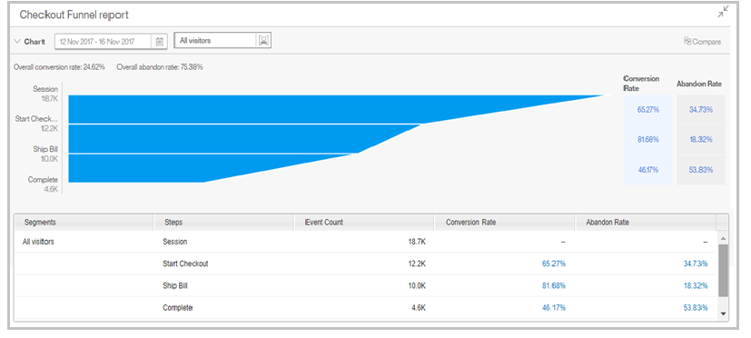






Visibility into business process performance
Root out inefficiencies in critical processes
Notes:
Using process reports in Watson Customer Experience Analytics, you can gain visibility into the overall performance of your business processes -- and identify individual process steps that may require improvements – allowing you to root out inefficiencies across the flow of your critical business processes.

Slide 12
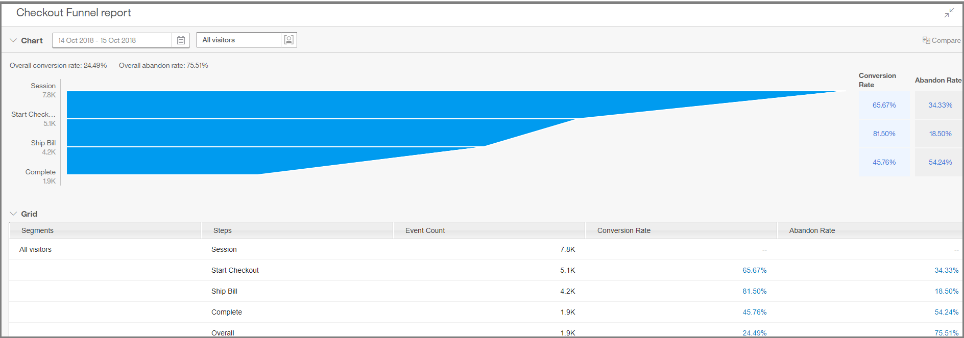

Measure business process success across steps
Start checkout
Ship Bill
Complete checkout abandonments over 50%!
Complete Checkout
Identify underperforming steps that may require optimization
Notes:
Business process scorecards help you measure and score your overall business process success by identifying the abandonment and conversion rates across and within each step of a critical business process and allowing you to easily identify process steps that include a percentage of abandonments that fall outside expected or typical percentages for your business.

Slide 13
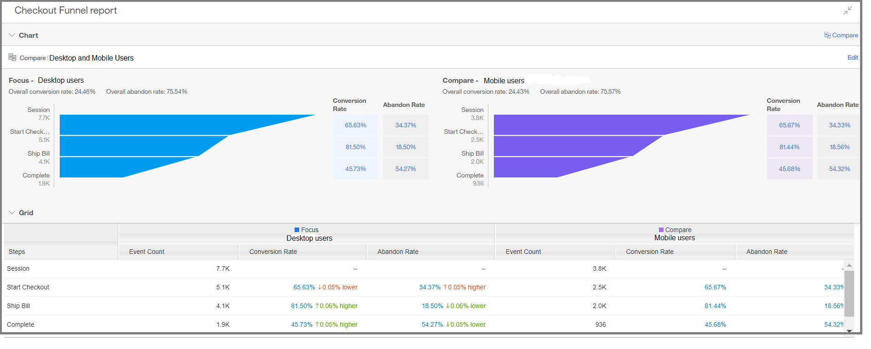
Use Segmentation to compare process performance
Identify underperforming segments and process steps requiring fine-tuning to optimize overall business process success
Notes:
Compare process reports for different segments – like desktop and mobile users -- across a common process flow to recognize segments that may be underperforming and process steps that require fine-tuning to increase the success of your overall business process

Slide 14


Geospatial Analytics: Where do your customers engage?
Engaging
Struggling
Insight to better understand how your business is performing across geographical areas
www.pereion.com
Notes:
By expanding your reach with geospatial analytics available in Watson Customer Experience Analytics (CXA), you can understand geographically where customers are engaging or struggling with your organization -- offering you additional insight you can use to make more targeted decisions about your business on a broader level.

Slide 15
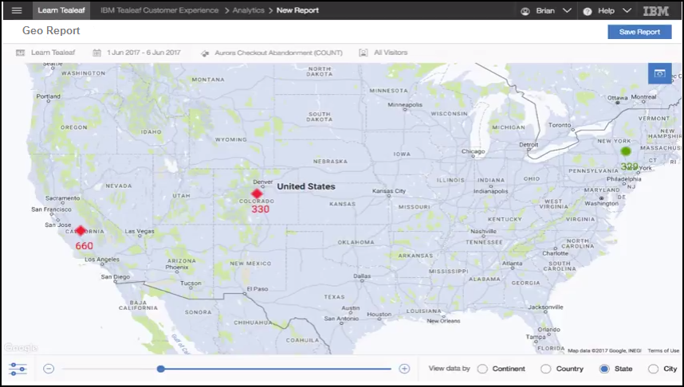
Geospatial analytics: reveal geographical trends in your business
Segment Data
Set Thresholds
Notes:
The capability to segment your customer data and set thresholds to measure positive and negative business performance allows you to identify particular geographical areas of your business that may require improvement or areas where business is doing exceptionally well and you may want to replicate success factors.

Slide 16




Geospatial analytics use cases
Remarket to customers who abandon
Optimize your site for global operations
Optimize mobile channel on a wide-scale level
Improve campaign effectiveness across your global business
Notes:
Geospatial analysis can be applied to many use cases and assists with targeting key areas of your business to maximize potential opportunities. Let’s take a closer look at one of the use cases where geospatial analytics can offer substantial benefits to your business…..

Slide 17
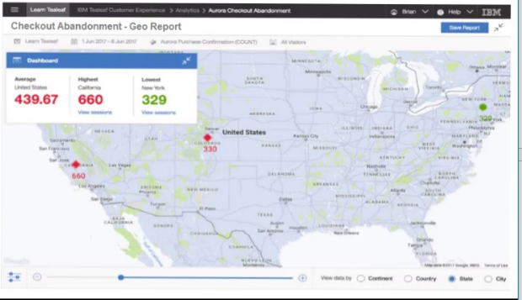

Use case: Remarket to customers who abandon
Threshold Exceeded
Launch targeted campaign or promotional offers
to encourage conversions and boost business
Notes:
By applying geospatial analytics to a report of online abandonment rates by state, you can recognize geographical areas where abandonments exceed your identified threshold, allowing you to remarket to customers in particular states with a targeted campaign or promotional offer for additional savings at a local storefront or a discount off their next online purchase, for example.

Slide 18


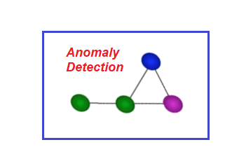
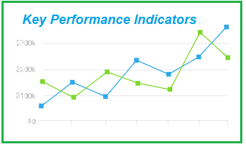
Anomaly Detection Metrics: Understand Unusual Customer Behavioral Patterns to Optimize Business Performance
www.pereion.com
Notes:
As an online business, you operate in a competitive and dynamic environment where it is critical to closely monitor many key performance indicators – and readily identify any anomalies with your business and quickly understand their root causes.

Slide 19
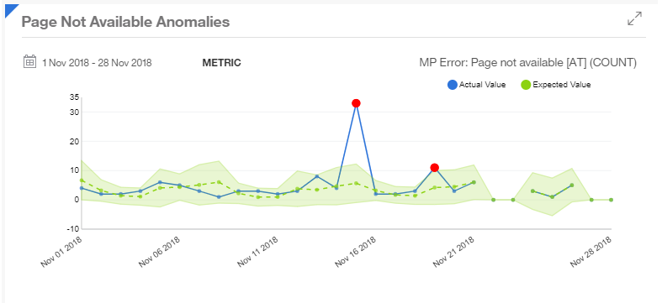
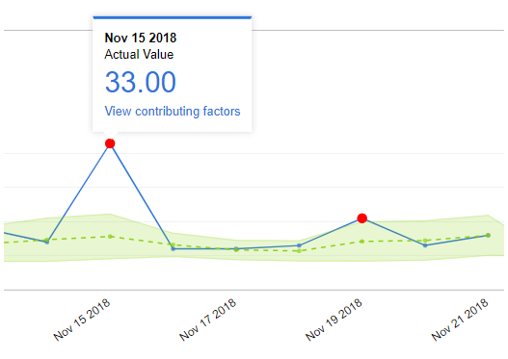
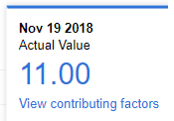


Apply anomaly detection to metric reports
Watson CXA
predictive analytics
Detect unusual patterns
Determine contributing factors
Gain insight to identify issues
Notes:
By applying anomaly detection to key metric reports using Watson Customer Experience Analytics, you can leverage the power of predictive analytics to detect unusual patterns, or outliers, in your customer behavior data and determine contributing factors – offering insight you can use to narrow in and identify issues.

Slide 20
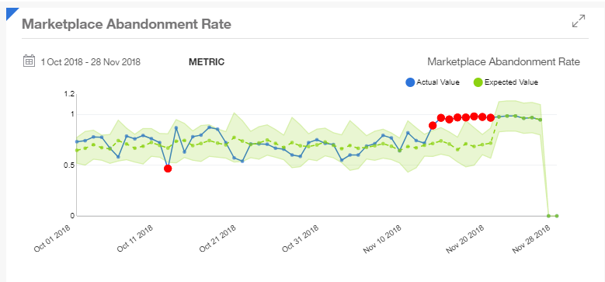
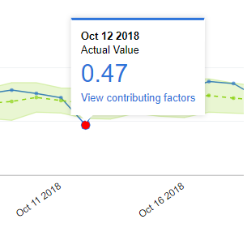
Anomaly detection will monitor metric against historical data
Calculate and quantify deviations and flag anomalies
Notes:
If you have a report that tracks abandonments on your site, for example, you can apply anomaly detection to your report to understand if any abandonments deviate from the norm. Anomaly detection will monitor the abandonment metric against historical data, calculate and quantify any deviations and flag any anomalies in the report.

Slide 21
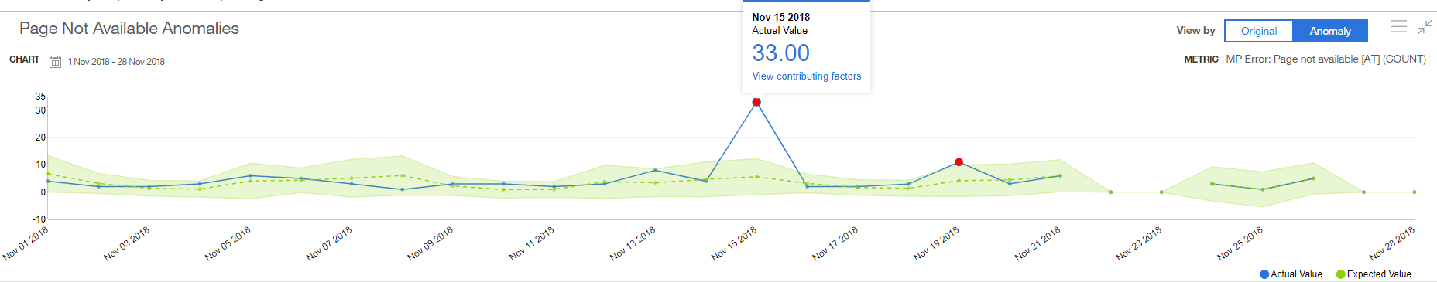
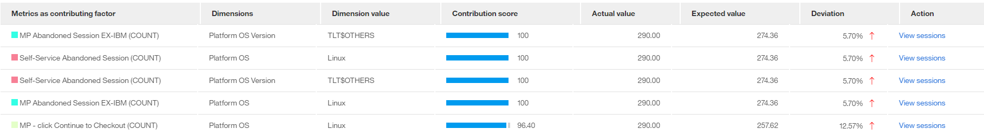

Drill deeper with session analysis
Macro to micro view
Better understand the root cause of the issue
Gain insight needed to take corrective actions
Notes:
By identifying outliers that could signal an issue and recognizing and ranking the contributing factors, you can then drill deeper with session analysis to better understand the root cause of the issue – offering you a powerful macro to micro view that provides the insight you need to take corrective actions.

Slide 22
Advanced Reporting Dashboard Management
Home
Bookmarks
Categories
Share with User Groups

Slide 23
Session Search & Analysis
Search for active and completed sessions
Search criteria based on time, session attributes, events, etc
Toggle between views of session attributes for quick analysis
Drill down to individual sessions
Session replay
Analyze session timeline based on every JSON user interaction
Review HTML request and response for every page
www.pereion.com

Slide 24
Session Search Tips & Techniques
Beta Interface
Search templates
Session list viewer

Slide 25
Alerts Setup & Management
New Alert Configuration
Monitoring
Best Practices

Slide 26
Training Sessions
Session 1: Advanced Reporting, Session Search, Alerts
Session 2: Event Development Overview
Session 3: All About Attributes
Session 4: Dimensions and Bringing it All Together

Slide 27
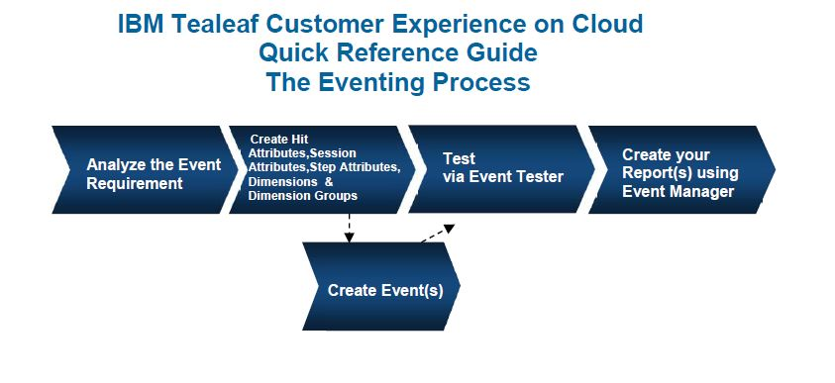
Event Development
Events are the fundamental building block of Tealeaf. Session data is recorded via an event.

Slide 28
What is an Event?
Events are the basis of all reporting in Tealeaf
Monitor your application data for conditions
Track when those conditions are met
Record information
Events are the data drivers for:
Identification
Searches
Problem Diagnosis
Reports
Workspaces
Notes:
Notes:
Events make sense of the data Tealeaf Records
Events are the foundation of all reporting data in Tealeaf. They can track almost anything that occurs on your company’s website by searching for matches to a set of user-defined conditions. Events:
Monitor your website and digital channels for conditions you define
Track when those conditions are met
Record information
Events are the data driversfor :
Identification – Easily see what happened in a Session
Searches – Quickly find the Session that matches your criteria
Problem Diagnosis – Determine barriers to business process completion
Reports – All reports and metrics are based on Events
Workspaces – High-level view of reports

Slide 29

How are Events defined?
When the Event conditions are matched, the Event fires. The Event can then:
Increment a counter (track it fired)
Set an additional Event value
Record additional Dimensions
Notes:
What is the data that Events monitor?

Slide 30
Event Development Analyze Requirements
What am I trying to capture?
What point in time?
What is the best means to capture (i.e. HTML, JSON)?
Do I have sample sessions?
Do I need to record a value?
What breakouts will I need?

Slide 31
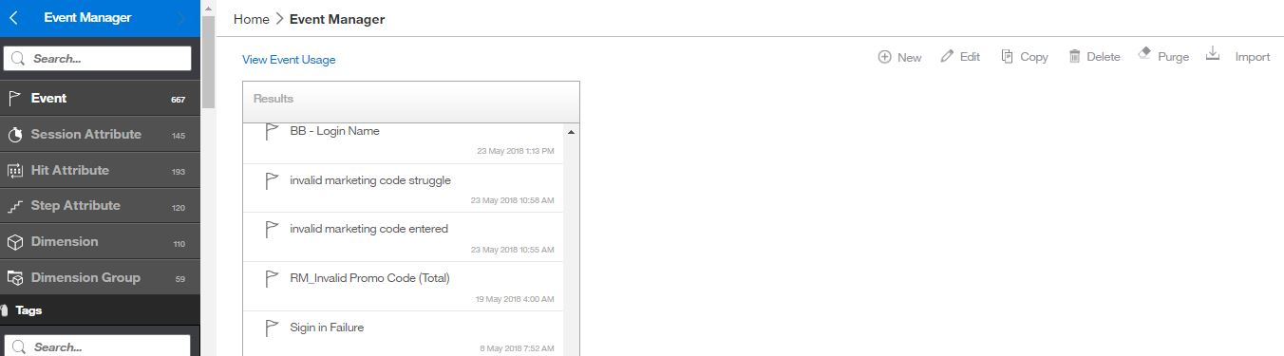
Event Development Event Manager Overview & Tour
Creation, configuration and management of all events, attributes and dimensions is done within the Event Manager.

Slide 32
Event Development Event Configuration
Basics
Optional
Name
Tags
Triggers
Conditions
Values
Dimensions
Description
Personal Data (Y/N)
Advanced Mode
Building Block
Geoanalytics

Slide 33
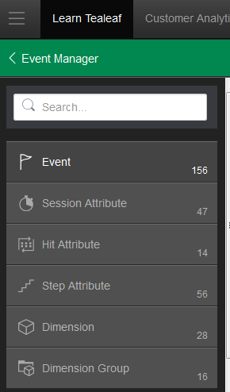
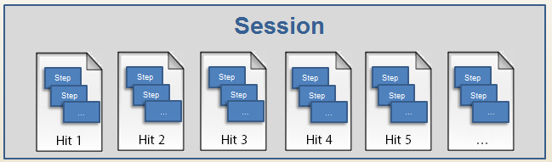
How do Events work?
Events record metrics for reports and search
Events monitor user data for conditions based on:
Step Attributes
Hit Attributes
Session Attributes
other Events
a combination
Notes:
How do Events evaluate that data?

Slide 34

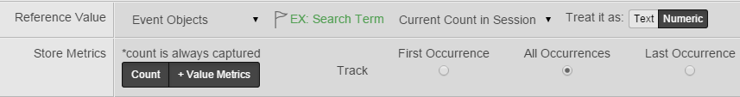
Event Values
When an Event fires, it always records a Count. It can additionally record:
Custom value
Event Objects
The value can be treated as:
Numeric
Text
The value tracked can be:
First
Last
All
Notes:
Notes:
Count Only - This selection is the default setting, and it records how many times the Event fires within a session.
Numeric - This selection causes the saved value to be treated as a numeric value as well as counting how many times the Event fired. Because the Event value is a number, calculations such as sum, max, min, and average values of this Event can be displayed on reports.
Text - This option causes the saved value to be treated as text, as well as counting how many times the Event fired.

Slide 35
What is Count good for?
Count tells you: Did something happen?
Track First per Session or Last per Session: Used for percentages
What percent of Sessions included a view of the shipping page?
Track Every Occurrence: Used for struggle or other analysis
Which Sessions had multiple views of the shipping page?
Notes:
Notes:
The following are examples of Events that are configured for count.
An Event that is configured to track successful registration (First per Session or Last per Session).
An Event that is configured to track a visitor’s last shopping cart total before abandonment (Last per Session).
An Event that is configured to track every time that a visitor examines their shopping cart (Every Occurrence).

Slide 36
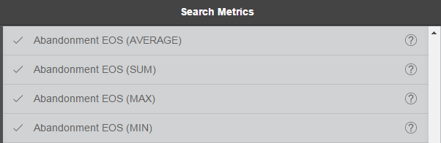
What is Numeric good for?
Numeric is good for any value that should be treated like a number
Sales amount
Duration for a process time
Allows functions to be performed on the value in reports: totals, minimum, maximum
Total revenue from a campaign
Average, minimum, maximum
Notes:
Notes:
Limitations of Numeric Values:
Not all numbers should be collected as numeric values. Although postal codes and order numbers are numeric information, performing calculations such as sums and averages would not make any sense. These values should be treated as text.

Slide 37
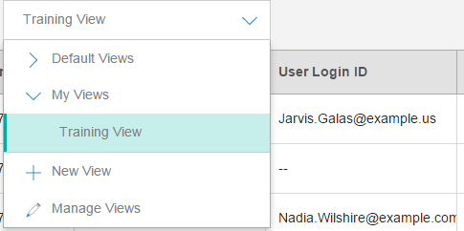
What is Text good for?
Text is typically used:
To facilitate search
As a Session Attribute, to display the value in a Session View
Or as a value for a Dimension
Notes:
Notes:
Limitations of Text Values:
Text is not useful as the base Event for a report, as the count of the Event’s occurrence is displayed, rather than the actual text values.
Some useful text values to record are:
Error messages
Referrers
Promotion codes

Slide 38
Event Development Event Tester
Test everything!
Select category
Select objects
Select sessions to test
Understanding test results

Slide 39
Training Sessions
Session 1: Advanced Reporting, Session Search, Alerts
Session 2: Event Development Overview
Session 3: All About Attributes
Session 4: Dimensions and Bringing it All Together

Slide 40



Data Capture: Steps, Hits and Sessions
Tealeaf processes data for Events
Visitor data
Session
Request
Step
Step
Step
Step
Step
Hit
Step
Step
Step
Step
Step
…
…
…
…
…
Response
Hit 1
Hit 2
Hit 3
Hit 4
Hit …
Step = JSON message
A Hit contains Steps
Session = all hits (steps) for a single user
Target
Page
(on SoftLayer)

Slide 41
Tealeaf Hits
Sessions consist of hits
Hits contain steps
Session
Hit 1
Hit 2
Hit 3
Step
Step
Step
Step
Step
Step
Step
Step
Step
Step
Step
Step
Notes:
To recap, a mobile session, like a web session, consists of hits. The hits contain additional step data that record the logging framework data. In the next section, we’ll take a closer look at the formatting of the step data.

Slide 42
What Are Steps?
Trackable user actions
Captured by Client framework
Bundled into hits
Each hit can have multiple steps.
A step can be considered a "subhit" of a hit.
Hit 1
Step
Step
Step
Step
Notes:
Steps are the user actions captured by one of the Tealeaf client frameworks in a specially formatted JSON format.
Each step is a trackable user action, or a server-side action that does not result from a user action (such as a redirect).
These actions, events and notices are bundled together and submitted as JSON messages to Tealeaf.
These messages are then inserted into the designated [StepAttributes] section of the request of the parent hit.
Each hit can have multiple steps.
A step can be considered a "subhit" of a hit.
A user action might consist of multiple steps. For example, to conduct a search, the user taps into a search field, enters a term, and then taps Search. Each of these actions (tap in, form field entry, tap out) can be recorded as a separate step.

Slide 43
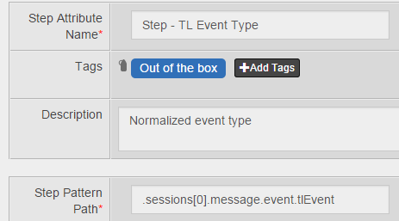
What is a Step Attribute?
Step: JSON message that contains user actions or other session data captured and sent by Tealeaf logging frameworks
Step Attribute: The path of an element in a JSON message
A Step
Notes:
All of the Tealeaf client frameworks send data in the form of steps. A single user action, such as logging in, can become multiple steps as logged by Tealeaf. These steps are batched together in the order they occur and sent as the request of a hit.
Step-based events examine each step within a hit for the wanted conditions. These Events can pull information from the current step that is being evaluated, the Hit that contains the step, and data from previously recorded Events.

Slide 44
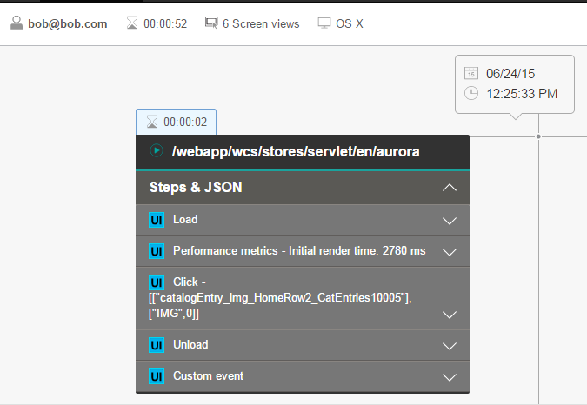
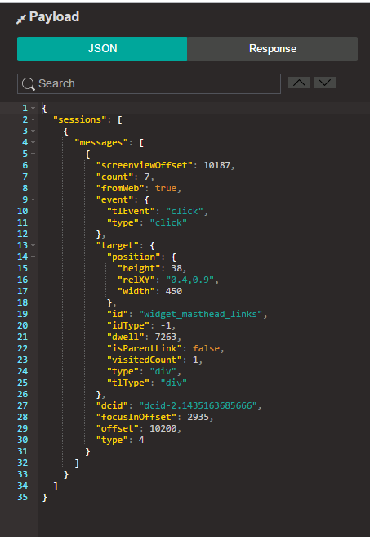
Where Can I See Steps?
Session Timeline
Replay Payload
ScreenView
Steps
Steps
Steps
Step

Slide 45
What are Custom Messages?
Tealeaf captures user interactions with application “out of the box”
Some data is not available through user interactions
Solution: Instrument custom messages in the JSON SDK data to “push” data to Tealeaf
Examples of custom messages:
Customer tier (regular, silver, gold, platinum)
JSON messages passed from web applications
VoC data
Tealeaf API calls

Slide 46
Message Types Reference
Type | Message Type | Description
1 | Client State | Current state of client
2 | Application Context | Screen views; what is loading and unloading
3 | Connection | Any request or response
4 | Control | User Interface fires an event
5 | Custom Event | Any Tealeaf custom code
6 | Exception | Errors
7 | Performance | Performance data
8 | Web Storage | Local storage info on the browser
9 | cxOverstat Hover | Mouse hover and hover-to-click info
10 | Layout | Display layout of native page
11 | Gesture | Touch event
12 | DOMCapture | Serialized HTML data (DOM snapshot) of the page
Notes:
A message type categorizes the messages for processing. Currently, there are following types of messages: ● 1: Client State - Current state of client. ● 2: Application Context - Message to indicate divisions in application view which could be current page/view/activity user is on. ● 3: Connection - Any request/response application performs during capture. ● 4: Control - User interface control that fires an event we listen to capture. ● 5: Custom Event - Any custom log event from any place in application. ● 6: Exception - Any exception application can throw. ● 7: Performance - Performance data from a browser. ● 8: Web Storage - An object containing information about local storage information on the browser. ● 9: Overstat Hover Event - An object containing information about mouse hover and hover-to-click activity. ● 10: Layout - Current display layout of native page. ● 11: Gesture - Gesture that fires a higher touch event we listen to capture. ● 12: DOMCapture - An object containing serialized HTML data (DOM snapshot) of the page.

Slide 47
Simple Events based on Step Attributes
Screenview
Click
Value Change

Slide 48
What are Hits?
Hits contain steps
Series of hits = Session
Most information in Steps
DOM capture data (Response HTML) can be captured in Hit Attributes
Session
Hit 1
Hit 2
Hit 3
Step
Step
Step
Step
Step
Step
Step
Step
Step
Step
Step
Step

Slide 49
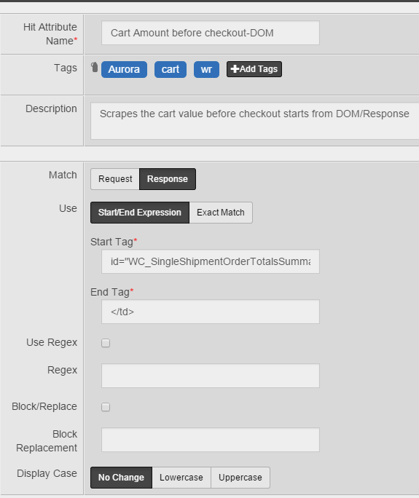
What Are Hit Attributes?
Hit Attributes look for patterns
Make data available for Event conditions and values
Can scrape values between start and end tags
Data in Request or Response
Data part of DOM capture from site
In Replay Payload Request or Response
Available for Hit Attributes

Slide 50
Hit Attribute Configuration
Error message (promo code)
Cart Value
New (show Regex and Blocking)

Slide 51
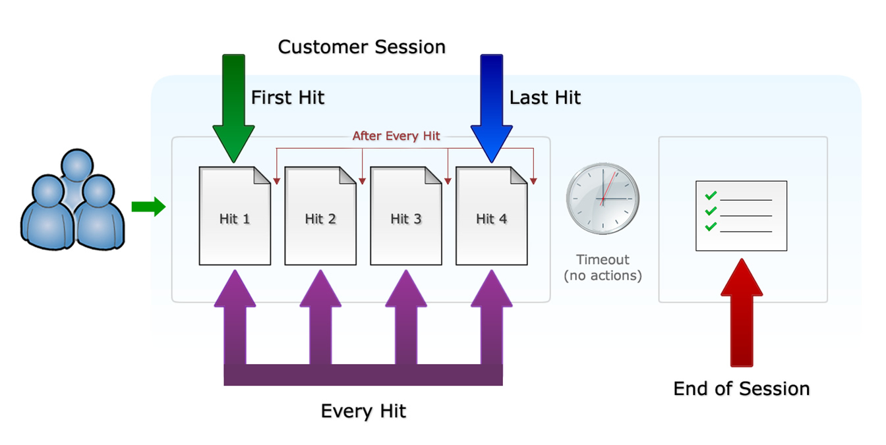
Event Trigger and Frequency Options

Slide 52
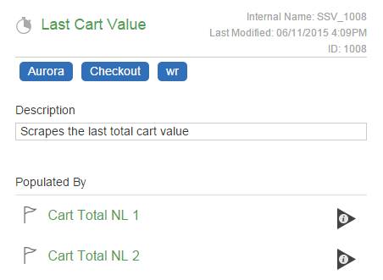
Session Attributes
Used as:
Event conditions and values
Dimension values
Session List Views
Populated by one or more Events
Uses the last value recorded

Slide 53
Session Attributes
Out of the Box
Custom

Slide 54
Training Sessions
Session 1: Advanced Reporting, Session Search, Alerts
Session 2: Event Development Overview
Session 3: All About Attributes
Session 4: Dimensions and Bringing it All Together

Slide 55
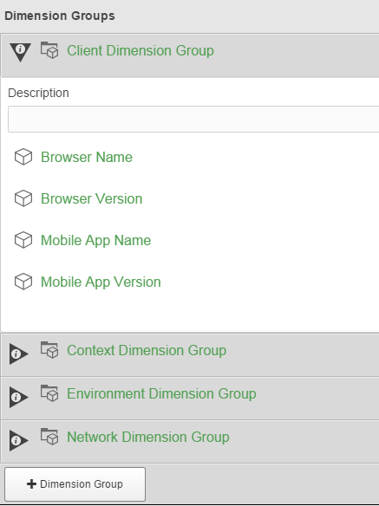
What are Dimensions?
Dimensions are used:
To drive breakouts in reports
As Event conditions
Built from Events, Step Attributes, Hit Attributes, or Session Attributes
Added to Events in Dimension Groups
Combine up to 5 Dimensions in a Dimension Group
Notes:
Dimensions capture information that is related to an Event when that Event fires. In this way, they act like a snapshot of other in-session data at the time the Event fires, and help you understand commonalities between sessions.
Dimensions function in Dimension Groups, meaning that you can ‘slice and dice’ a report’s data segment by multiple Dimensions if those Dimensions are in the same Report Group.
Dimensions provide a way to:
Segment Event data in reports
Narrow down search results
Serve as Event conditions
Dimensions can be built from Hit Attributes, Events, or Session Attributes, and are added to Events in the Dimension Groups tab.

Slide 56
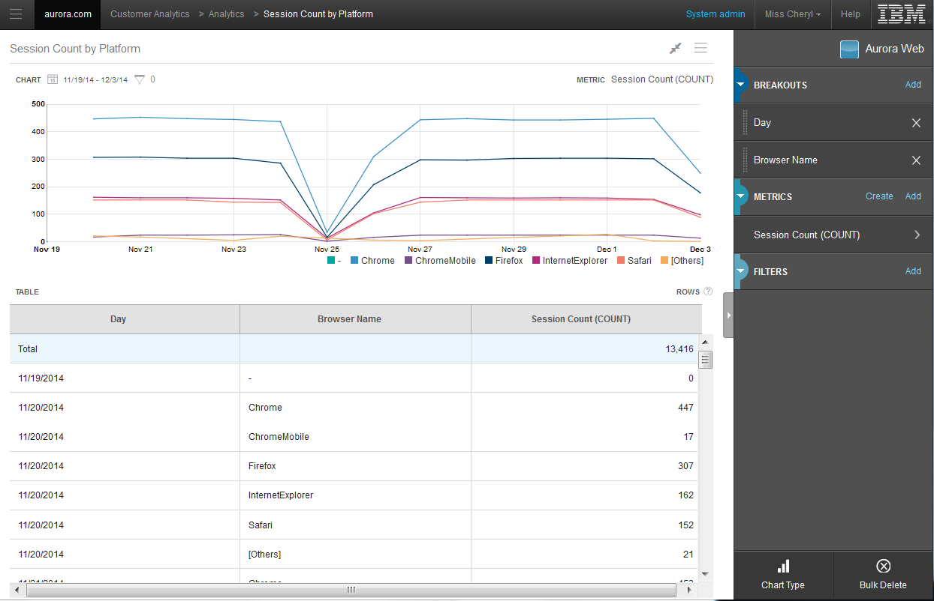
What are Dimension Groups?
Let you breakout and filter report data
Recorded when Event fires
Contain up to five Dimensions
Notes:
Dimensions function in Dimension Groups, meaning that you can ‘slice and dice’ a report’s data segment by multiple Dimensions if those Dimensions are in the same Dimension Group.
For example, since the Browser Name and Browser Type Dimensions are in the same Dimension Group (called “Client Dimension Group”), you would be able to view the Browser Names by version in a report.

Slide 57
Event or Dimension?
“I want to see x broken out by y”:
x=Event value
# of abandonments
$ abandoned
Avg. time spent on process
Session counts
y=Dimension
Platform
Browser Name
Browser Version

Slide 58
Setting up Dimensions and Dimension Groups
System parameters
Page parameters ( URL, referral)
Geographic
New

Slide 59
Hands on Lab Exercise End to End Example
Build basic Screenview event for error page
Apply Systems Dimension and Page Parameter Dimension Groups with Geo turned on
Setup Reporting:
Browser Stacked Bar
Grid with URL, Referral, and calculated metric for rate of occurrence
Geospatial report
Configure an Alert

Slide 60
Question & Answer
Parking Lot
New questions
www.pereion.com

Slide 61
Additional Resources
Use Case Videos
Learning Portal
www.pereion.com

Slide 62
Tealeaf and Watson CXA Use Cases
Priority Use Cases
Geospatial Analytics - Learn and understand where your customers are engaging and struggling geographically
Struggle Analytics - Detect and analyze customer struggle on your site in real time
Heat Map Analysis - View where customers are interacting with your pages and understand customer behaviors for different segments
Journey Analytics - Visualize and understand customer journeys across time, devices and channels
Business Process Scorecards - Gain visibility into the performance of your business processes and identify individual process steps that may need improvement
Real-time Alerting - Identify and instantly be alerted to the first signs of customer struggle on your website
Search Optimization - Achieve advanced insights into how customers engage with content and what they are searching for on your website
Anomaly Detection - Identify unusual patterns and irregularities in customer behavior data and uncover contributing factors
Check out https://www.pereion.com/watsoncxausecases

Slide 63
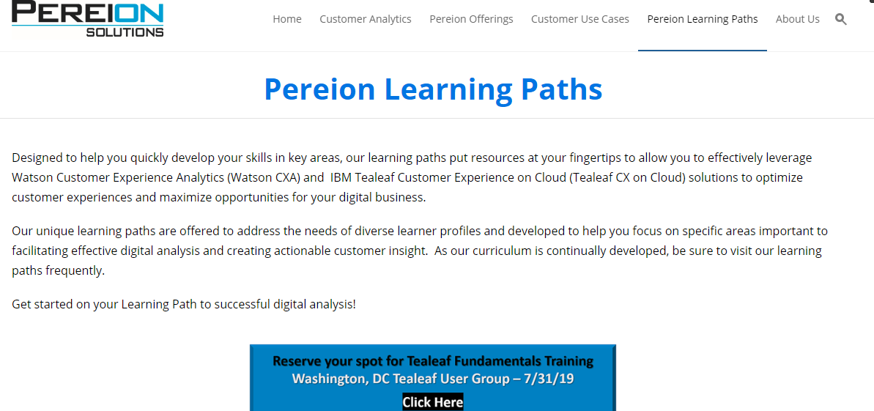
Announcing New Tealeaf and Watson CXA Learning Portal
www.pereion.com/pereionlearningpaths

